Slide 1
How Hot Was March?
Kevin Shu, Jackson Knapp, Max Eiseman

Slide 2
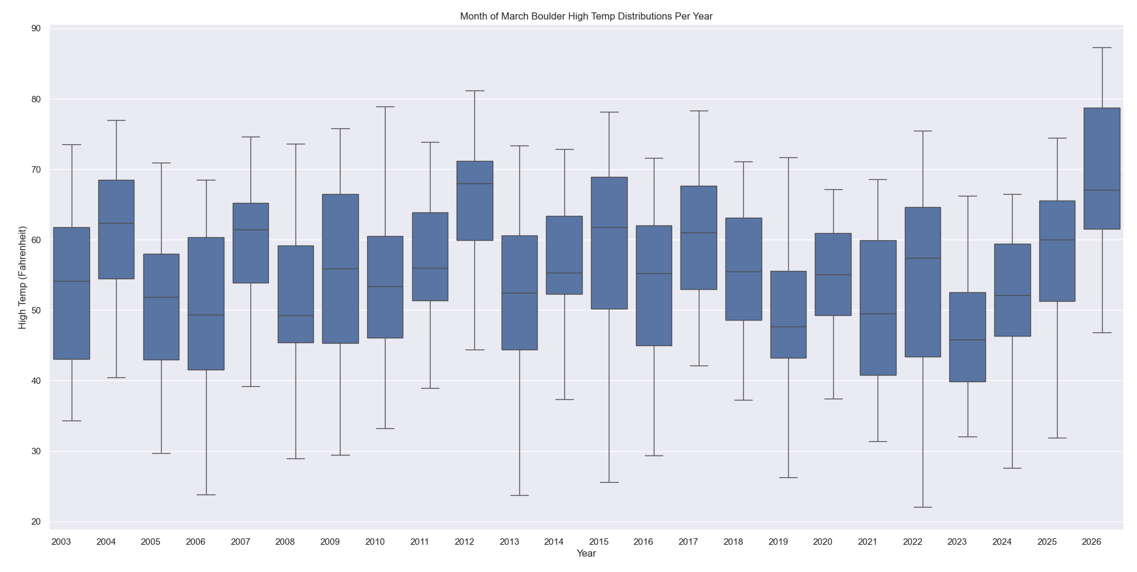
Visualization showing the distributions of March’s high temps across the years in Boulder. 2026 stands out with notably high quartiles and range. Using API data from coagmet.colostate.edu, created by Kevin Shu.

Slide 3
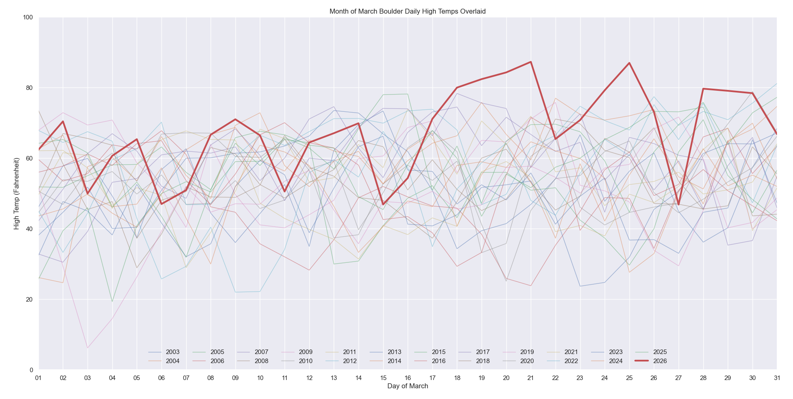
A day-by-day look at March’s high temps in Boulder and how they compare to previous years. Using API data from coagmet.colostate.edu, created by Jackson Knapp.

Slide 4
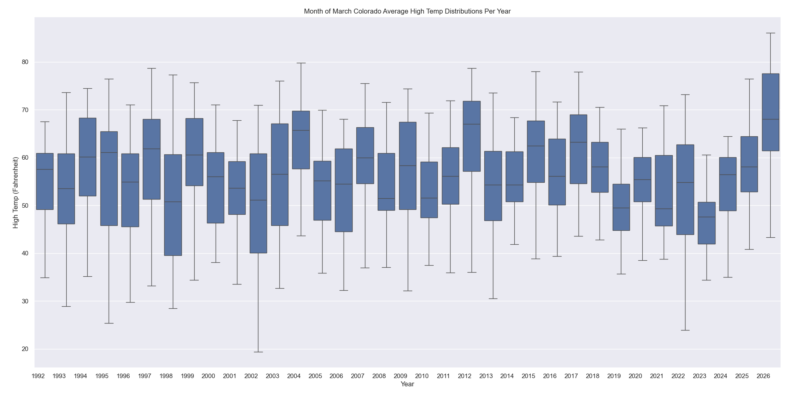
The distribution of March’s high temps across the years, averaged across all stations in Colorado. Using CSV data from coagmet.colostate.edu, created by Max Eiseman.

Slide 5
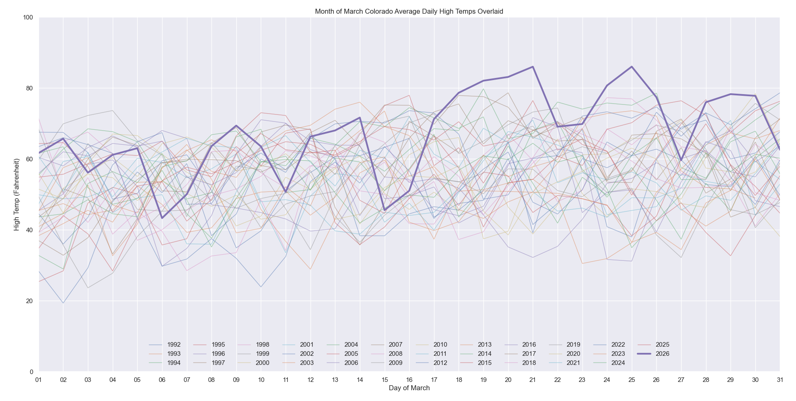
A day-by-day look at March’s high temps in Colorado and how they compare to previous years. Using CSV data from coagmet.colostate.edu, created by Kevin Shu.

